Slide 1
Route Prediction and Navigation
Presented By:
Praveen

Slide 2
Contents
Goal
Motivation
Challenges
Implementation
Security
Results
Future Work/ Improvements

Slide 3

Goal
Predict the route taken by a vehicle using devices other than GPS.
Compass.
Accelerometer.
Total time of journey.
Process ROS(Robotic Operating System) data.
Use a search-based algorithm.

Slide 4
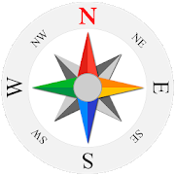
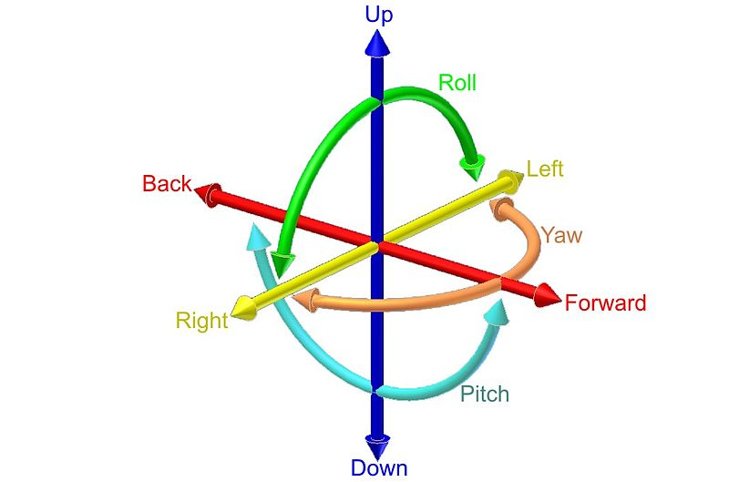
Motivation
Disadvantages of GPS.
Need line of sight to lock onto satellites.
Usually blocked by skyscrapers
Availability of sophisticated sensors.
IMU
Brake sensors
Steering angle

Slide 5


Challenges
Noise in sensor readings.
Large Difference in distance calculation.
Understanding and Extracting Roll Pitch Yaw from quaternions.
Working with Open Street Map data and setting up related environments.

Slide 6
Implementation
Extract relevant information from ROS bag.
Conversion from one representation to another.
Choices to start search.
Use all points on map -> Many matching points
Use intersection of roads to mark both start and end. -> Considerably less points to start with.
Conversion of OSM XML to data in PostGIS.
Conversion from PostGIS to SVG(Scalable Vector Graphics).

Slide 7
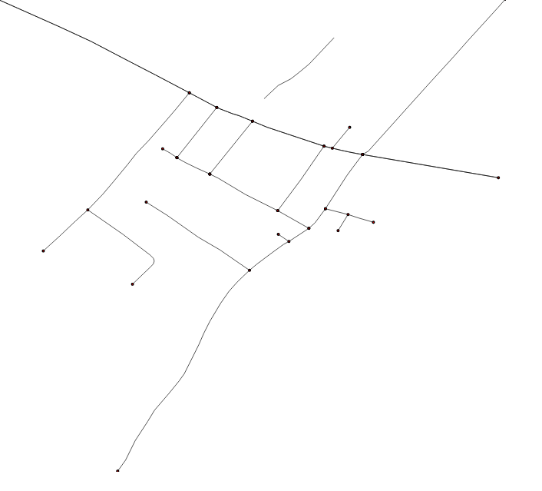
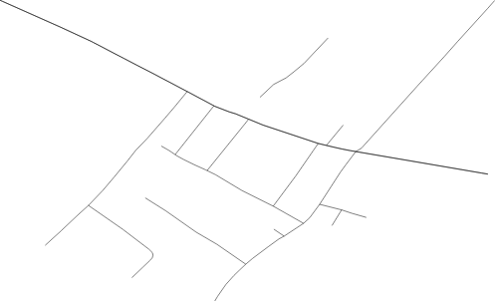
Implementation
Road Extracted from kartograph.
Road with Intersections. Road ends are also
Considered as Intersections

Slide 8
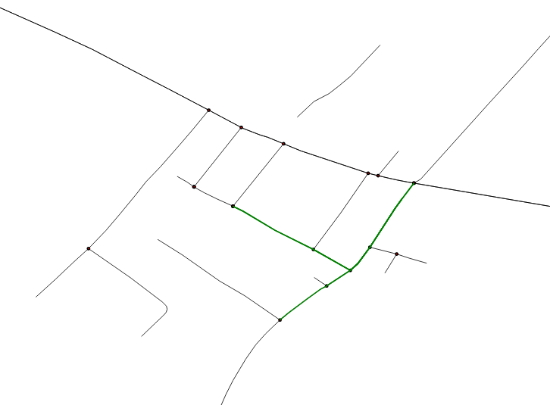
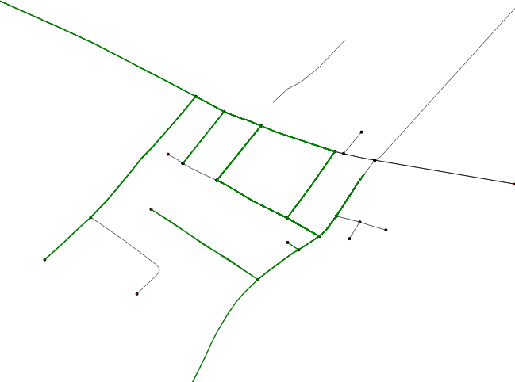
Implementation
Route selected for two angles
Route selected 4 angles

Slide 9
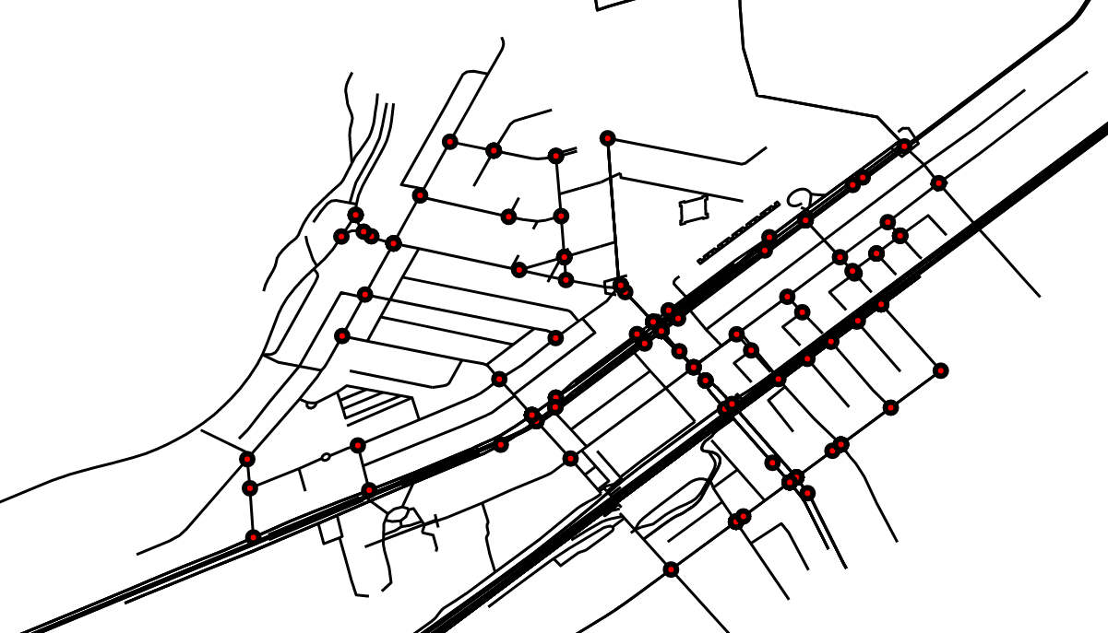
Implementation
Using the IMU data from ROS bag to calculate azimuth angles.
Feeding those values to the program we get.

Slide 10
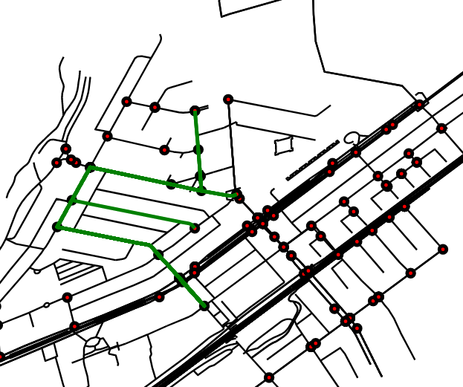
Implementation
Route selected from IMU values

Slide 11
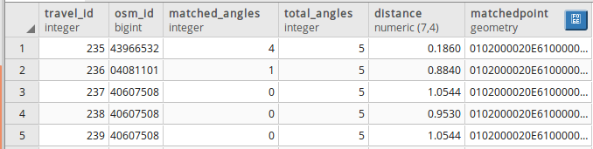
Implementation
Accuracy increases with number of turns.
Distance and angles matched are utilized to rank the selected routes.
Works well with initial GPS location.
If just azimuth angles are provided path is considered from each intersection.

Slide 12
Security.
Route can be predicted just by turns and some approximate knowledge of locality.
IMU accuracy is required. Might pose a threat to community.
Can be used for tracking and monitoring of vehicles when GPS is not available.

Slide 13
Results
Couldn’t use all the info from ROS.
Recursive find intersection helps to find all possible routes and rank them.
Error correction.
Using ML with steering angle velocity and Compass can give a better result.

Slide 14
Future Work
Turn prediction based on steering angle and wheel angles.
Using distance by filtering the signal.
Considering one ways.
Show simulation using ROS data.
Classify time based on traffic details.

Slide 15
Question? ☺

